Slide 1
Risk and Fraud Management
Yann Gouedo
Data Scientist Leader – Machine Learning / Artificial Intelligence
Marketing / Risk / Fraud / Maintenance
IBM Certified Senior Data Scientist & IBM Certified Senior Architect

Slide 2





Fraud is a deliberate deception or misrepresentation which violates a legal statute and is intended to produce an undue financial gain
Scope includes
Financial crime including money laundering, cyber attack and illegal security breach.
Abuse which similar to fraud but not determined to violate the law.
Waste & Error refer to improper payments which are the result of over paying due to poor policies or operational mistakes
Risk includes financial, operational, IT and security risks and financial crimes which all must be identified, monitored and controlled.
Staged events
Money laundering
Improper billing Improper payments
Organized
Provider
Organized
Opportunistic
Individual
Employee
Slip and fall
Arson Tax fraud
Medical fraud
Procurement
Financial statement Expense
Notes:
2

Slide 3




Four capabilities are needed to defeat Fraudsters
Operational Disruption
Security
Rules
Detect
Prevent
Predict and Protect
Detect fraud within a business process
Take action in real time – when it matters
Disrupt and Defeat
Investigate
Fraudster
Discover
Confirm fraud for prosecution, recovery, rules, and watch lists
Find fraud within the data
Prosecute and Recover
Learn and Apply
Smart
Analytics
Big Data
Analytical Discovery
Notes:
Detect: Detect if a request or transaction brought forward by a customer, employee, or partner is likely fraud
Prevent (or respond): Take the next best action once fraud has been identified
Discover: discover fraudulent providers, schemes, firms, or other actors thru retrospective analysis of data
Investigate: Confirm suspicions by efficiently and effectively investigating identified fraud

Slide 4


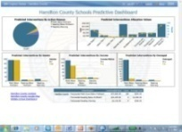


Counter Fraud Solution Framework
Operational Systems
Advanced Industry Libraries:
Data Models, Predictive Models, Rules, Reports, Process, External Fraud Data and so on
Real Time / “In line”
Back Office Analytics
Reporting
Prevention
Detection
Discovery
Investigation
Integration
Predictive Analytics
Selection
Case Management
Action
Evaluation
Operational Reporting
Rules
Relationship Visualization
Guidance
Anomalies
Dashboards
Decision Management
Identification
Investigative Analytics
Rules
Feedback
Observation Space
Information
Domains
Internal Sources
External Sources
Evolving Unstructured Sources
Fraud Use Case Libraries

Slide 5
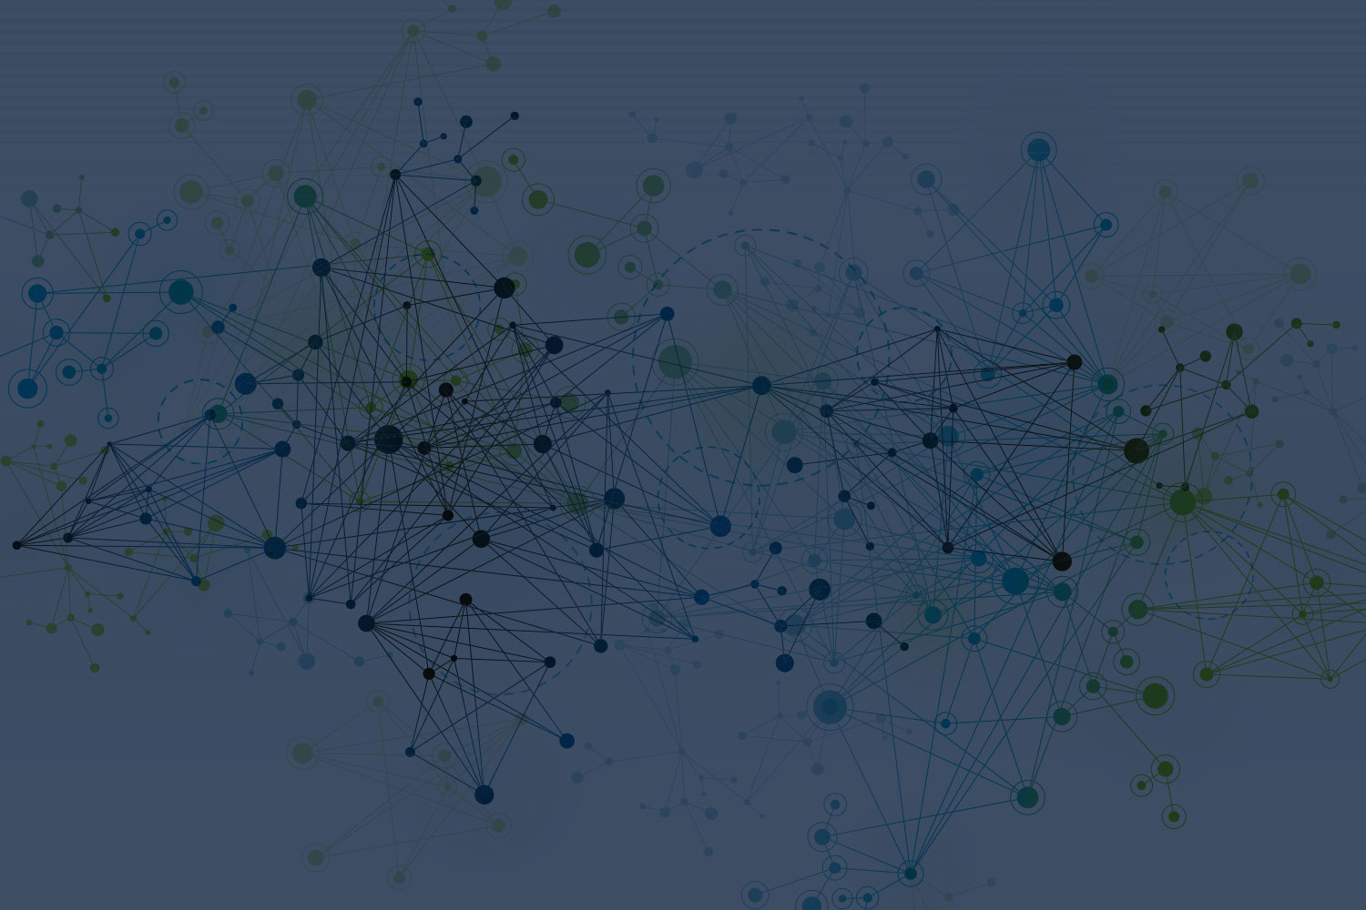
Customer use case

Slide 6

PRO BTP uses analytical tools for real-time detection of suspicious claims for medical expenses
Identified
9% of suspicious claims in optics and 14% in dental
14 million euros
is the potential damage over a period of 21 months
Reduced
management costs and improved service
Business challenge: PRO BTP is the social protection group for French building and construction professionals. It offers members (employees, retirees, craftsmen and construction companies) services in the areas of pension and health insurance (provident, health and savings). The firm had been using a processing system that was identifying unjustified health claims only after they had been paid. To reduce system abuses and better control expenses, PRO BTP needed to detect suspicious claims before the company reimbursed health professionals.
The smarter solution: Teaming with PRO BTP, IBM developed a secure service platform dedicated to detecting, categorizing and fighting fraud, service abuses and errors. Thanks to a detection engine validated by experts, this service platform, named Solon, analyzes optical and dental reimbursement claims in real time so that the firm can evaluate them before payment or before establishing a charges agreement. The platform features enriched predictive models that it can use to help detect fraud networks, and it is based on self-learning technology that pools detection schemes and takes advantage of an observatory watch.
“We plan to extend the process to all of our health insurances, and eventually even to some provident benefits.” —Paul Grasset, chief executive officer
Solution components
IBM Fraud and Abuse Management System
IBM Counter Fraud industry solution
IBM® InfoSphere®
IBM SPSS® Decision Management
IBM WebSphere® Application Server
IBM Operational Decision Manager
IBM i2® Analyst’s Notebook®
IBM Global Business Services® – Consulting and Application Management Services
IBM Global Technology Services® – Integrated Technology Services
IBM PureFlex® System
IBM Client Center at La Gaude
Notes:
Link to Reference Profile: http://w3-01.ibm.com/sales/ssi/cgi-bin/ssialias?infotype=CR&subtype=NA&htmlfid=0CRDD-9HBJV5&appname=crmd
About the client
Based in Paris, PRO BTP is France’s first social security provider for the construction and civil engineering industries. The group supports nearly 3.10 million members, providing products and services that include complementary retirement, non-life and life insurance, health services, savings, leisure and social activities.
Business challenge
As a social security and insurance organization, PRO BTP helps protect its over three million members against the financial consequences of social risks, such as illness, disability, old age and unemployment. To this end, it aims to provide the appropriate level of benefits and payments to the right recipients on time. Although not an early concern, fraud became a growing challenge for the group, with improper payments representing 5 – 10 percent of its total refunds. This problem hindered not only the client’s productivity, but also its ability to fast-track claims assessed as valid. At the time, however, the organization’s claims review and fraud detection methodologies were manual, random and sporadic, plus the company lacked the tools to monitor and prevent system abuse.
Solution
Commencing with a proof of concept (POC), PRO BTP and IBM signed a 7-year joint agreement to build and operate a unique platform for fraud and abuse management. A First-of-a-Kind (FOAK) project in France, the sophisticated counter-fraud platform employs data-mining capabilities, advanced algorithms, business rules and statistical models to identify and flag potentially fraudulent data. Sifting through millions of dental and optical insurance claim data points, the solution identifies abuse patterns and questionable outlier behaviors, and it scores the claim for its fraud risk level. The organization uses the intelligence to prioritize claims investigation, further validating and scrutinizing claims before making payments, potentially avoiding millions of euros in losses. The engagement’s ultimate goal is to market and sell the system as a counter-fraud as a service (CFaaS) solution to private insurance providers in France’s health and social security markets. As a service provider, PRO BTP helps build and sell the service and will be the first anchor client.
Quantifiable benefits
The POC was highly successful, identifying new cases and configurations of fraud that PRO BTP was unaware of. The solution will help the company avoid payment of suspicious claims while speeding the payment of valid claims, potentially saving millions in cost avoidance. During the POC, the solution identified 9 percent of optical claims and 14 percent of dental claims as suspicious.
What makes it smarter
Instrumented - The platform sends refund requests from healthcare providers to specialized hubs that concentrate the anonymous data and then electronically transmits the requests to the organization and counter-fraud platform.
Interconnected - By consolidating and scoring millions of claims data points collected from numerous claims systems and databases, the solution generates a scoring report card that the group uses to identify potentially fraudulent claims, investigate claims or even prosecute fraudsters.
Intelligent - The solution sifts through millions of dental and optical insurance claims, using advanced algorithms, business rules and statistical models to detect patterns of fraud and score and rank claims. The solution flags for further investigation claims that suggest fraudulent activities or unusual billing behaviors before the organization makes payments decisions.

Slide 7




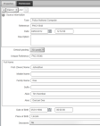
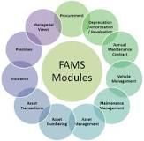
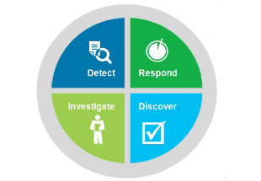

A partnership between PROBTP and IBM for the creation of a counter fraud service
Customer 1
Customer 2
Customer 3
Customer 4
Counter Fraud Management
…
Customer n
Suspicious Request of reimbursment
Health Practitioners Scoring
Recommendations for the recovery and blocking payments
Notes:
Qui est PROBTP ?
Groupe de protection sociale du Bâtiment et des Travaux Publics, PRO BTP est au service de 3,5 millions d'adhérents et de 208 000 entreprises. A but non lucratif et à gestion paritaire, PRO BTP propose des prestations et des services aux salariés, retraités, artisans et entreprises du BTP, dans le domaine de la retraite, de la prévoyance et de la santé, de l'épargne, de l'assurance, de l'action sociale et des vacances.
Le Groupe dispose d’un réseau de 114 agences Conseil de proximité, implantées sur toute la France pour accueillir, informer et conseiller ses adhérents. En 2013, l’activité de PRO BTP, 1er groupe professionnel de protection sociale, a représenté 6,5 milliards d’euros de cotisations dont 3,7 milliards de cotisations retraite et 2,7 milliards de cotisations au titre de l’assurance de personnes (prévoyance, complémentaire santé, assurance et épargne individuelle).
En quoi consiste le partenariat avec IBM ?
IBM annonce la signature d’un accord d’une durée de 7 ans avec PRO BTP, l’un des principaux organismes de protection sociale en France, dont l’objet est le développement et la mise en place d’une plateforme unique de lutte contre la fraude à l’assurance des soins de santé. Construite sur les logiciels et services d’IBM de lutte contre la fraude, la plateforme « Solution as a Service (SLaaS) » SOLON permet d’identifier les demandes de remboursements ou de prises en charge suspicieuses, de qualifier celles-ci en temps réel et de définir leurs modalités de traitement.
Leading social protection group France supporting ~ 200k companies, 1.5m employed people, 1.8m pensioners and which
provides a range of products: Complementary Health Insurance Prevoyance, Pensions
PROBTP opère ce partenariat auprès des clients, IBM construit la solution de Détection de Fraude
Solution de Détection de Fraude :
Suite au développement de la dématérialisation des échanges entre autres, les possibilités d’abus ou de fraude ont augmenté et par exemple, les paiements indus représentent 5 à 7% du total des remboursements effectués par PRO BTP. Dans ce contexte, la plateforme SOLON permettra à l’opérateur de santé d’identifier les dysfonctionnements, au moment du paiement, dans les remboursements des soins de santé optique et dentaire. PRO BTP sera alors en mesure ainsi de réduire ses coûts et d’améliorer son service.
Délivrée en mode Cloud (SLaaS), la solution SOLON sécurisée utilise des solutions et services d’Analytics d’IBM qui permettent, par l’analyse de millions de données détenues par PRO BTP, de repérer en temps réel les abus de prestation et les comportements atypiques dans les domaines de l’optique ou du dentaire. A partir d’un échantillon de données Pro BTP, la plateforme a été testée sur 21 mois de prestations ce qui a permis de détecter 9% de demandes suspicieuses en optique et 14% en dentaire pour un préjudice éventuel estimé à 14 millions d’euros. Cette détection a été réalisée grâce, entre autres, à des outils d’analyse prédictive d’IBM et de nombreux indicateurs.
Prépaiements : Demandes de prise en charge et Demande de remboursements (Alertes: suspicions de fraude de niveau demandes, catégorie de configuration et modèles d’actions )
Post-paiements : Demandes de remboursements « réglées » (Alertes: suspicions de fraude et atypisme de niveau PS, adhérents et bénéficiaires, catégorie de configuration et modèles d’actions )

Slide 8
Counter Fraud Solution Framework
Operational Systems
Advanced Industry Libraries:
Data Models, Predictive Models, Rules, Reports, Process, External Fraud Data and so on
Real Time / “In line”
Back Office Analytics
Reporting
Prevention
Detection
Discovery
Investigation
Integration
Predictive Analytics
Selection
Case Management
Action
Evaluation
Operational Reporting
Rules
Relationship Visualization
Guidance
Anomalies
Dashboards
Decision Management
Identification
Investigative Analytics
Rules
Feedback
Observation Space
Information
Domains
Internal Sources
External Sources
Evolving Unstructured Sources
Fraud Use Case Libraries

Slide 9
The Proof of Concept / Proof of Business: Business Value First Findings - True stories based on 21 months of client‘s data
Identified
9% of optical and 14% of dental claims as suspicious cases in POC
Millions of euros
potentially saved in
cost avoidance
50% of claims
scored as highly suspicious identified and validated
1
2
3
One beneficiary who “bought” 26 glasses
A network fraud between a beneficiary and his wife who was …. dental assistant!
Many cases where we saw more than 8 dental prosthesis for kids under the age of 15 years old
4
5
6
Contact lens for children under the age of 10 years old
Many claims for the same practitioner → Services not performed /delivered has been billed (medical care, glasses, lens…)
Huge number of claims in the same month for the same practitioner (end of the year)
Notes:
La plateforme a été testée sur 21 mois de prestations ce qui a permis de détecter 9% de demandes suspicieuses en optique et 14% en dentaire pour un préjudice éventuel estimé à 14 millions d’euros.
Un échantillon sur les demandes de remboursement suspicieuses a permis de valider 50 d’entre elles comme fraudes avérées. Dans le reste des 50%, les cas suspicieux ont été classifiés comme : faux positifs, erreur de gestion interne et non valides
----- Meeting Notes (26.01.15 11:45) -----
2 ans

Slide 10
PoB’s Fraud detection methodologies
The first approach works by apply business rules helping to detect suspicious cases, tuned with statistical information (mean, standart deviation, ….)
The second approach works by finding anomalies in behavior that could indicate fraud
The third approach is based on known business rules and indicators and creates suspicious cases scores / profiles of Practitioners
The fourth approach is based on known fraudulent cases et creates fraud patterns to apply on new claims
Deviation modeling
Anomaly Detection
Profiling
Scoring

Slide 11
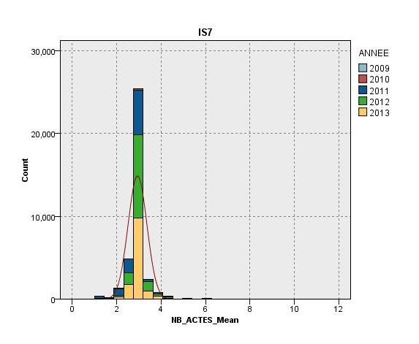
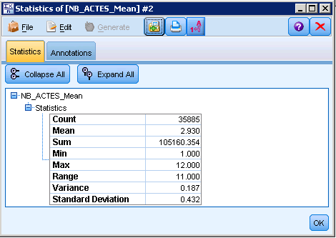
Methodology 1) Business Rules and Descriptive Analysis
Deviation modeling
The objective is to highlight potential alerts of fraud, thanks to business rules and statistics
8 Business Rules for Optic and 3 for Dental, following different analysis axis as the client
22 statistical indicators, following different analysis axis as the client
Relevant list of alerts: (number>= 4 (3,794= mean (2,93) + 2 * standard deviation (0,432)))
Rule only: Alerts on 1000 Beneficiaries (500 Practitioners concerned)
Rule + Statistics: Alerts on 50 Beneficiaries (234 Practitioners concerned)
Notes:
L’application d’une règle seule remontait 1000 Bénéficiaires en alerte (500 Professionnels de Santé concernés)
L’application d’une règle affinée par un indicateurs statistiques remontait 50 Bénéficiaires en alerte (234 Professionnels de Santé concernés)

Slide 12
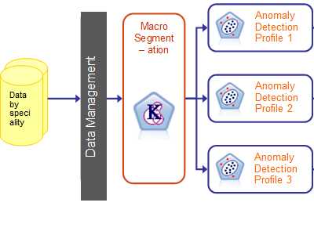
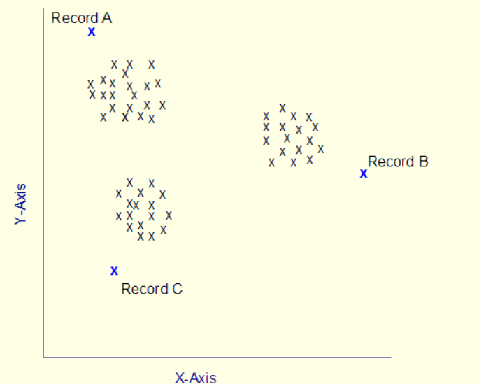
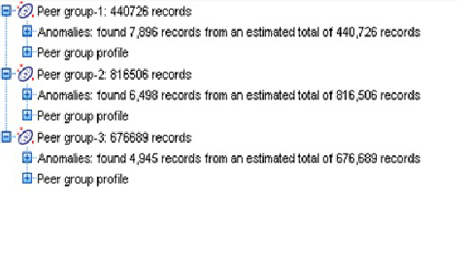
Methodology 2) Anomaly Detection methodology
Anomaly Detection
The objective is to highlight anomalies, and so potential fraud, thanks to the « anomaly detection » mathematical technique
Anomaly detection is the search for items or events which do not conform to an expected pattern.
Anomaly detection is an non supervised method: it does not require a training dataset containing known cases of fraud to use as a starting point
Notes:
12

Slide 13
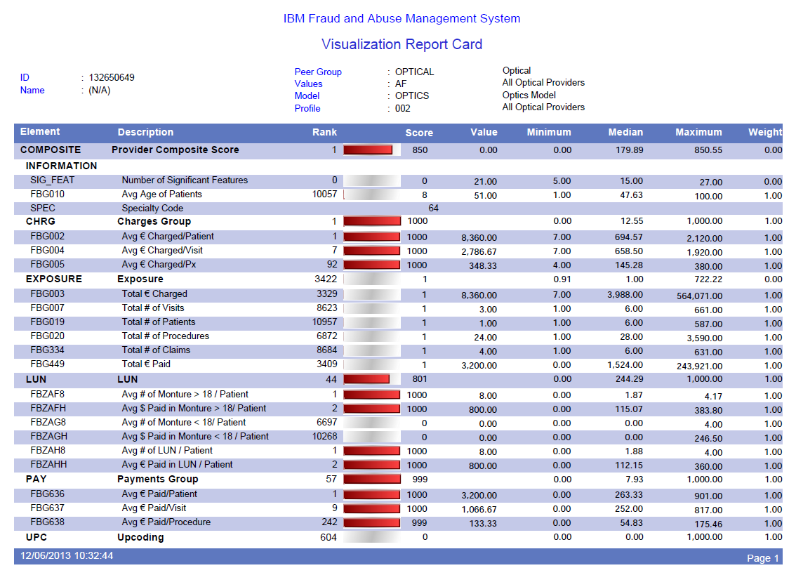
Methodology 3) FAMS methodology
Profiling
The objective is to profile Practitioners, then to determine the risk of fraud, thanks to insights and statistics
This methodology is based on an IBM asset/solution, named « Fraud and Abuse Management System».
Fraud Risk Scoring
It is based on business rules and Practitioners attributes and statistics (like the total of visits) from the Healthcare industry:
Identification of abnormal behaviors for a given speciality and location
Built with more of 7000 indicators from 40 implemented projects (public sector and private customers)
Notes:
13

Slide 14
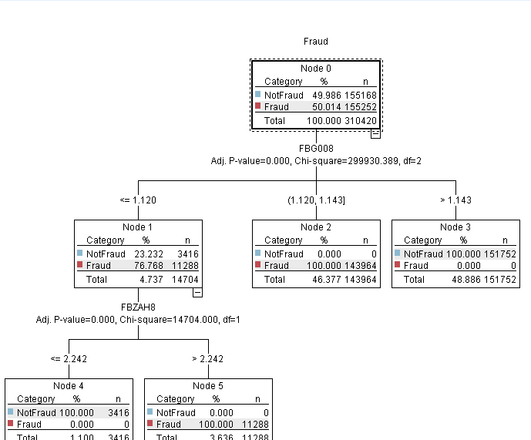
Methodology 4) Predictive Fraud patterns
Scoring
The objective is to detect fraudulent new requests of reimbursment, thanks to predictive fraud patterns
This methodology is based on known fradulent cases and creates predictive patterns or models able to identify criteria or variables explaining the fraud
Predictive patterns are applied on new requests of reimbursment
This methodology is supervized, that means it is based on historical known fraudulent cases. It uses classification predictive models (decision tree, neural networks, …).
Target : Fraud
First factor explaining the fraud
Second factor explaining the fraud
Notes:
Il est également possible de créer des patterns permettant de trouver les faux positifs, les erreurs de gestion internes, …
14

Slide 15
Thank You
Yann Gouedo
Data Scientist Leader – Machine Learning / Artificial Intelligence
Marketing / Risk / Fraud / Maintenance
IBM Certified Senior Data Scientist & IBM Certified Senior Architect

